Slide 1
Stroke Risk Rate Under 65
John Paul Medina
June 20, 2025

Slide 2
Goals:
• Explain why we are focusing on patients under 65 years old
• Identify the top risk factors that contribute to stroke cases under 65
• Identify the relationship between the top risk factors and age
• Explore recommendations for preventive care and health care planning for patients under 65

Slide 3
Why 65 and Under?

Slide 4
Patients 65 and Above Have an Average of More Than 1 Medically Alterable Risk Factor
Medically Alterable Risk Factors: heart disease, hypertension, glucose level, smoking, and BMI

Slide 7
The Top Risk Factors Account for 2 to 7 Times More Stroke Cases than their Population Share
Heart disease account for 14.44% of all stroke cases while only representing 2.35% of the overall population

Slide 10
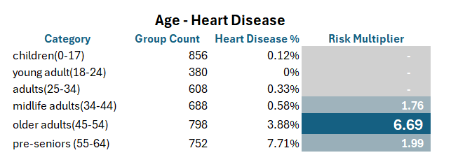
Age and the Top Modifiable Risk Factors

Slide 11
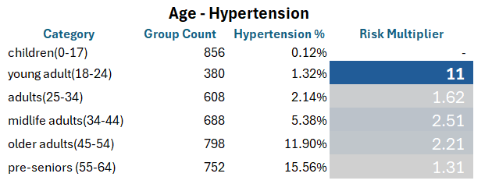
Hypertension Risk Spikes by Age 18, Consistent with CDC Screening Guidelines
Source: Centers for Disease Control and Prevention. “High Blood Pressure.” CDC.gov, 2024. cdc.gov/bloodpressure

Slide 13
High diabetes or uncontrolled diabetes stroke rate is 7.46%

Slide 14
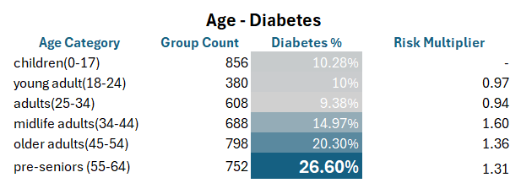

Slide 16
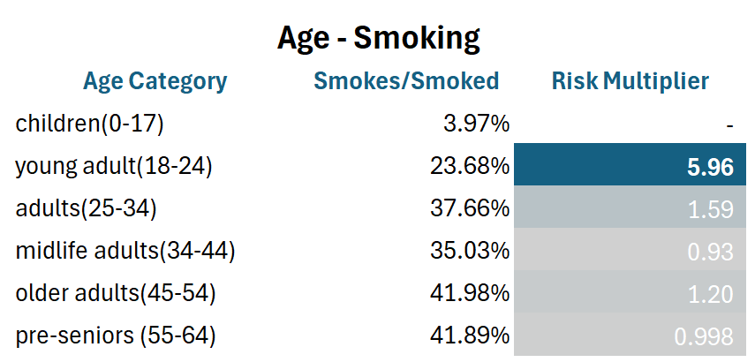

Slide 17
Recommendations:
Heart Disease (13.54% risk)
35
Screening and Preventive Care Plan
Heart Disease Rate Jumps 6x by Age 45
Diabetes
25
Screening and Preventive Care Plan
Diabetes Rate Increases Rapidly Starting at Age 25
High Uncontrolled Diabetes Stroke Rate is 7.46%

Slide 18
18
Hypertension (5.97% risk)
Blood Pressure Screening and Preventive Care Plan
Hypertension Rate Jumps 11x from Child to young adult age
Smoking (3.79% risk)
Anti-Smoking Campaigns and Behavioral Health Intervention
Nearly 1 in 4 Patients Smoked by the young Adult Stage
Stroke Risk Remains Elevated Even After Quitting

Slide 19
Call to Action:
Prevention is better than treatment, stroke risk factors may develop well before the age of 65.
Screening and prevention plans should begin as early as age 18 to 35, depending on individual risk factors.
Public health leaders and providers can reduce stroke burden by updating protocols and targeting the right age groups.
Future Work: Build a Machine Learning Model to estimate patient risk using patient’s current health profile.

Slide 20
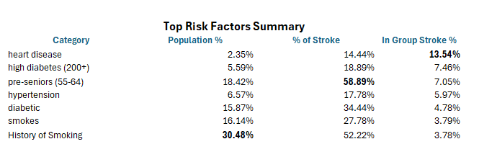
Summary and Questions

Slide 21
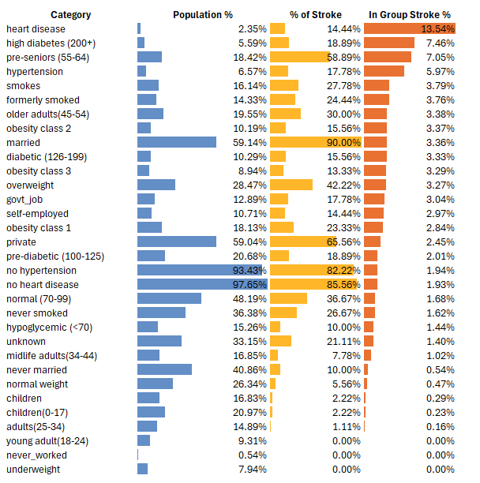
Appendix:
Full Stroke Risk
Breakdown by
Category

